Slide 1
CTI League
Disinformation
2020-07-18
Support: Medical Disinformation Resilience Think Tank

Slide 2
Disinformation Support

Slide 3
CTI League’s 4 types of (current) services
1. Neutralize malicious activities in the cyber domain with takedown, triaging, and escalation relevant information for sectors under threats.
2. Prevent attacks by supplying reliable, actionable information (IoCs, vulnerabilities, compromised sensitive information and vulnerabilities alerting).
3. Support the medical sector and other relevant sectors with services such as incident response and technical support.
4. Act as clearinghouse for data, a connection network and a platform for facilitating those connections.

Slide 4
Disinformation versions of those services
Neutralise: This is the disinformation takedown, triage and escalation work listed under disinformation incident response below.
Prevent: This is work that we could be doing - collating and supplying disinformation IoCs and vulnerabilities to the organisations, especially the health organisations, that we work with. For example, if we identify that a “Reopen $STATE” campaign is attempting to organize another “Operation Gridlock” incident, we can alert state, city, and county officials, as well as any hospitals in the target area.
Support: We’ve seen few direct cognitive security attacks on medical facilities so far. We have seen attacks directed at high-profile medical individuals and general attacks. We can assess the possibility of direct attack, and ways to be ready for that. For example, we could prepare resources that could be used in countering campaigns that target COVID-19 field hospitals.
Clearinghouse: We have connections established, but haven’t built ourselves as a clearinghouse yet. We could. We could also coordinate this work with those who are focusing on response and countercampaigns (the “elves” who fight the “trolls”).
Notes:
BigBook: https://docs.google.com/document/d/1eeXoFtQpqthhVSBm91wer0uhS346lt3SEhU04ojQaPs/edit#

Slide 5
Direct Targeting

Slide 6
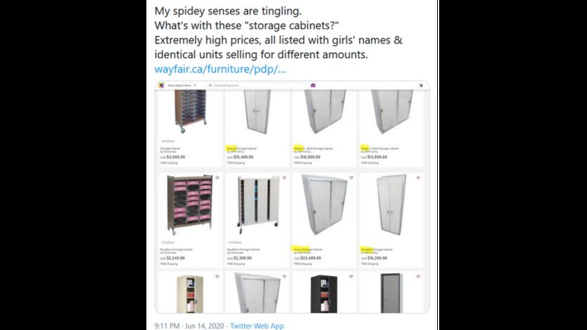
Organisations: Qanon on Wayfair
Notes:
https://www.bbc.com/news/world-53416247

Slide 7
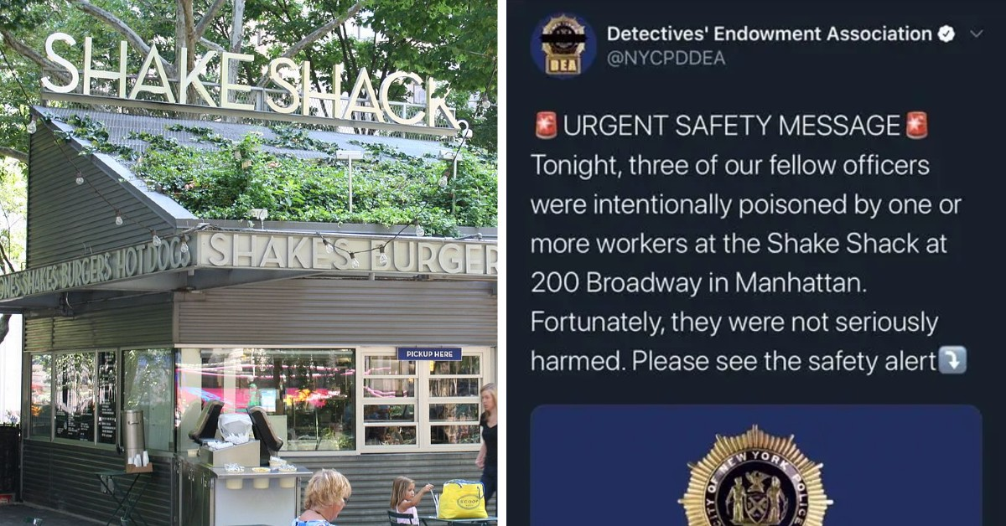
Organisations: NY police on ShakeShack
Notes:
https://www.snopes.com/ap/2020/06/17/nypd-says-officers-were-not-poisoned-at-shake-shack/

Slide 8
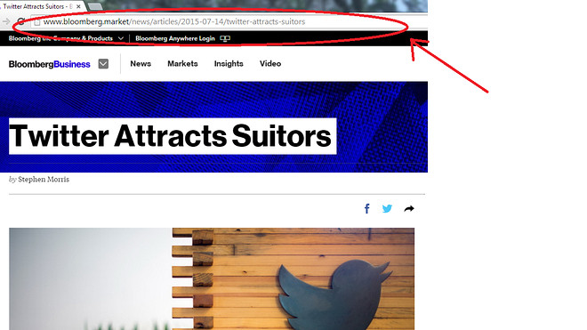

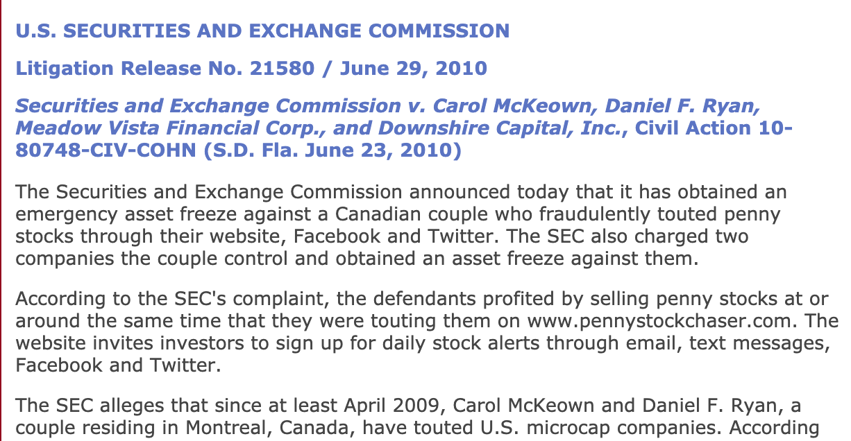
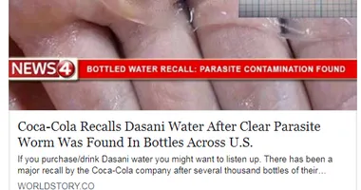
Attention, Power, Money, Geopolitics…
Notes:
https://www.washingtonpost.com/outlook/fake-news-threatens-our-businesses-not-just-our-politics/2019/02/08/f669b62c-2b1f-11e9-984d-9b8fba003e81_story.html

Slide 9
Medical

Slide 10

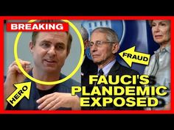

High-Profile Individuals: some/no defence
Notes:
https://www.npr.org/2020/06/29/884551391/florida-scientist-says-she-was-fired-for-not-manipulating-covid-19-data

Slide 11
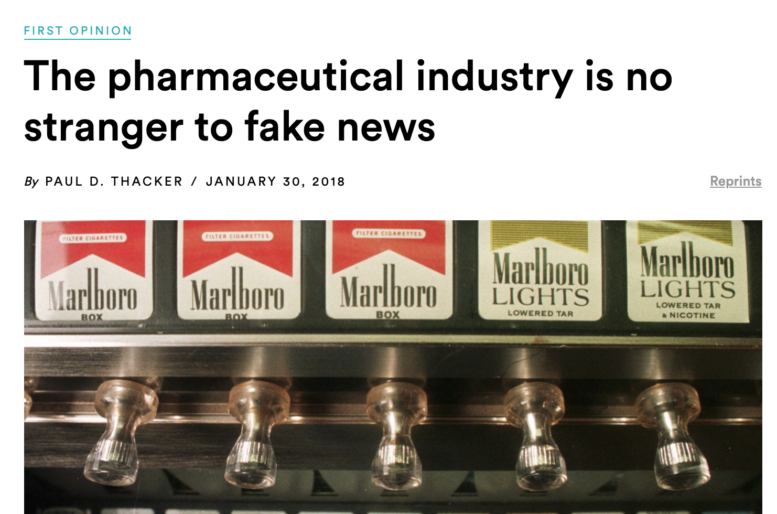
Pharma: already have “product defence”
Notes:
https://www.statnews.com/2018/01/30/pharmaceutical-industry-fake-news-tobacco/

Slide 12
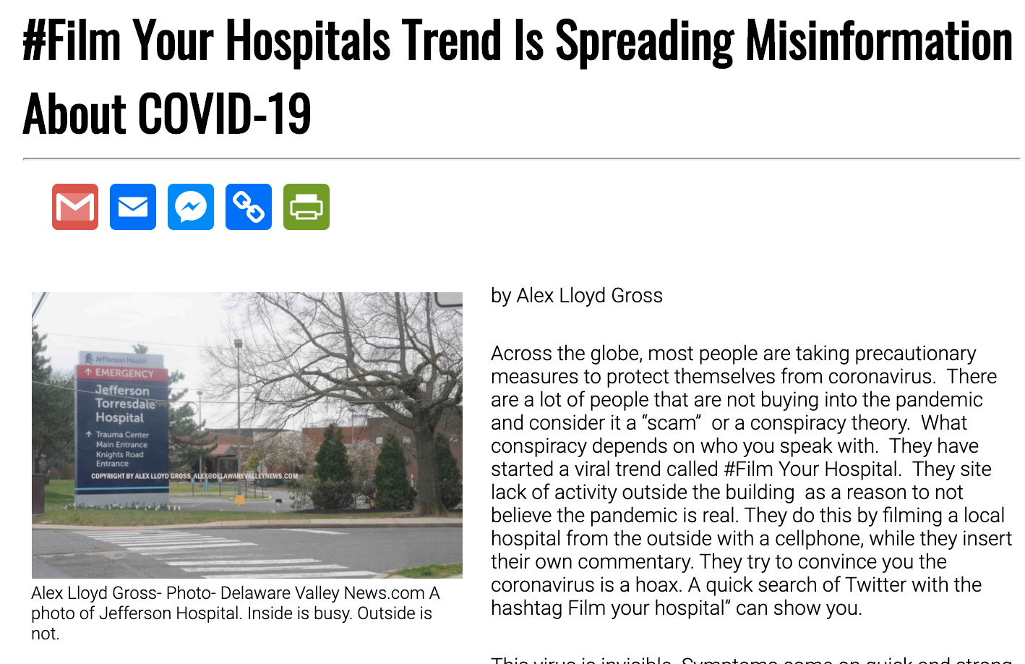
Small/Medium Health Facilities: anything?
Notes:
http://delawarevalleynews.com/2020/04/05/film-your-hospitals-trend-is-spreading-misinformation-about-covid-19/

Slide 13
… And hybrid attacks
Disinformation amplifying twitter hijack
Disinformation using communities to amplify ransomware attacks

Slide 14
System? Counters?

Slide 15
Toolset
Existing neutralise/prevent assets
Existing social media / marketing profiles
Threat models
Mitigation and countermeasure models
Red-team exercises
Advice notes (we have to write these)

Slide 16
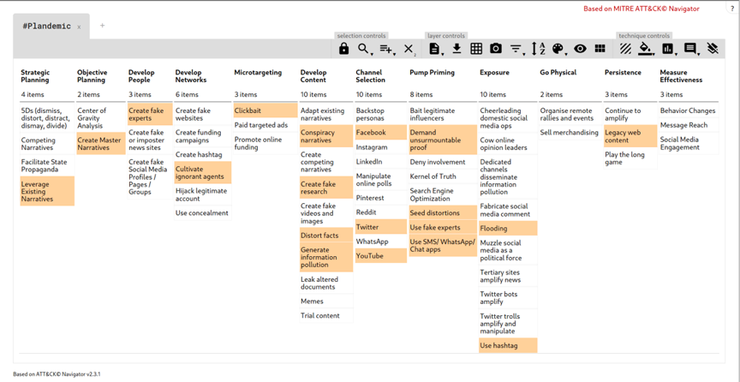
Models: AMITT
Notes:
https://github.com/cogsec-collaborative/amitt_framework

Slide 17
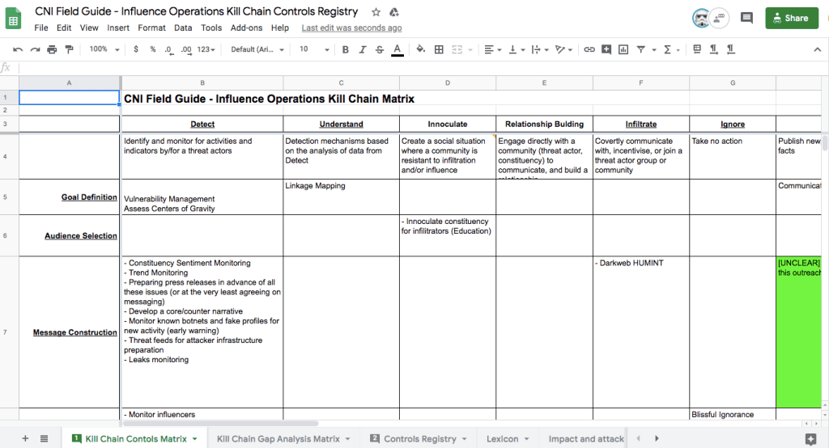
Models: ACoD
Notes:
https://essenceofwonder.com/2020/05/02/countering-fake-news-professionals-panel/
(Or ask [Name Redacted] , [Name Redacted] , or any of the other Disinformation team members who are also part of the ACoD team)

Slide 18
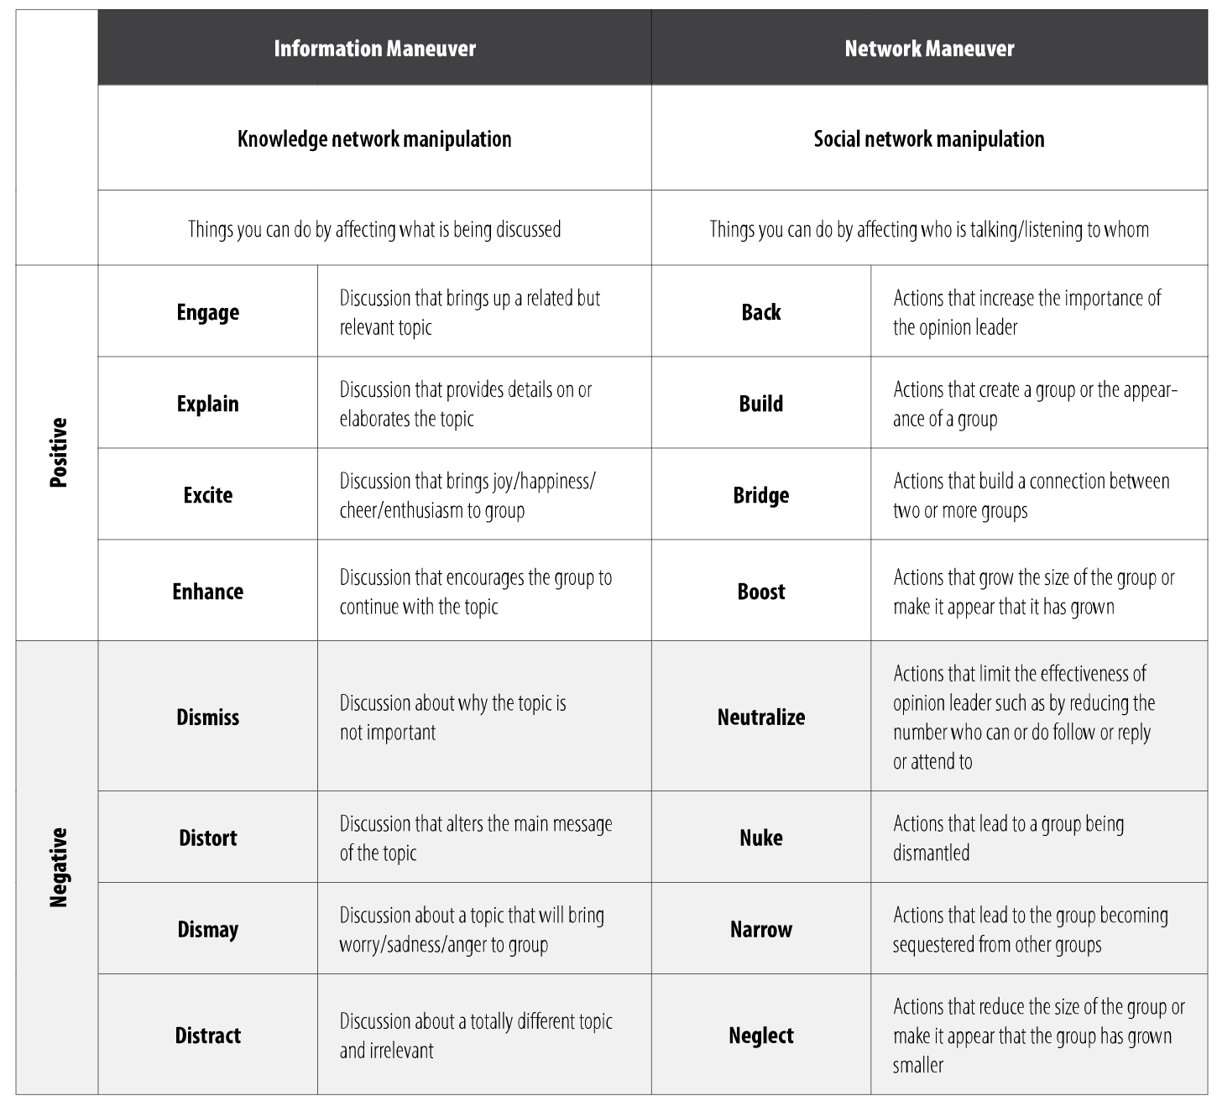
Models: BEND framework
Notes:
https://www.armyupress.army.mil/Journals/Military-Review/English-Edition-Archives/Mar-Apr-2019/117-Cybersecurity/b/

Slide 19
Mitigations & Counters
Countermeasures are that form of military science that, by the employment of devices and/or techniques, is designed to impair the operational effectiveness of enemy activity. Countermeasures can be active or passive and can be deployed preemptively or reactively.
JP 3-13.1 , Information Operations - Joint Chiefs of Staff
Notes:
https://github.com/cogsec-collaborative/amitt_counters

Slide 20
Over to you, think tank...

Slide 21
Questions
Is this a real problem? Is this likely to become a problem?
What might the problem look like?
How can we practically help?
What can we do now to make this suck less?

